Slide 1
@rahatcodes
Building better communities with mental health support

Slide 2
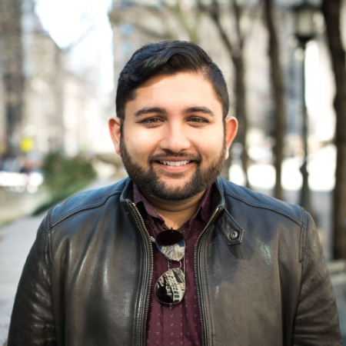
Rahat Chowdhury
Software Developer
Podcast Host
Speaker
Mental Health Advocate
@rahatcodes
@tech4humansio

Slide 3
200
Million

Slide 4
That means I’m not alone.

Slide 5



Open Source Mental Illness (OSMI)
Non-profit, 501(c)(3) dedicated to raising awareness, educating and providing resources to support mental wellness in the tech and open source communities.
For the workplace
For Employees
For Executives and
HR Professionals

Slide 6
Today’s topics
01 - Bootcamps
02 - Tech Events

Slide 7
I need to put in extra work everyday to get better.
I may have taken on more than I can handle…
I can’t figure any of this out, just forget it.

Slide 8
Your amazing Bootcamp experience does not invalidate others bad experience.

Slide 9

Hustle Culture

Slide 10
Having a passion for tech is not a requirement to be great at tech.

Slide 11
Tech Events

Slide 12
Are you focusing too much on one type of event?

Slide 13

The Pac-man Rule
- Eric Holscher

Slide 14
@rahatcodes
We don’t suffer alone, we suffer in silence

